Slide 1
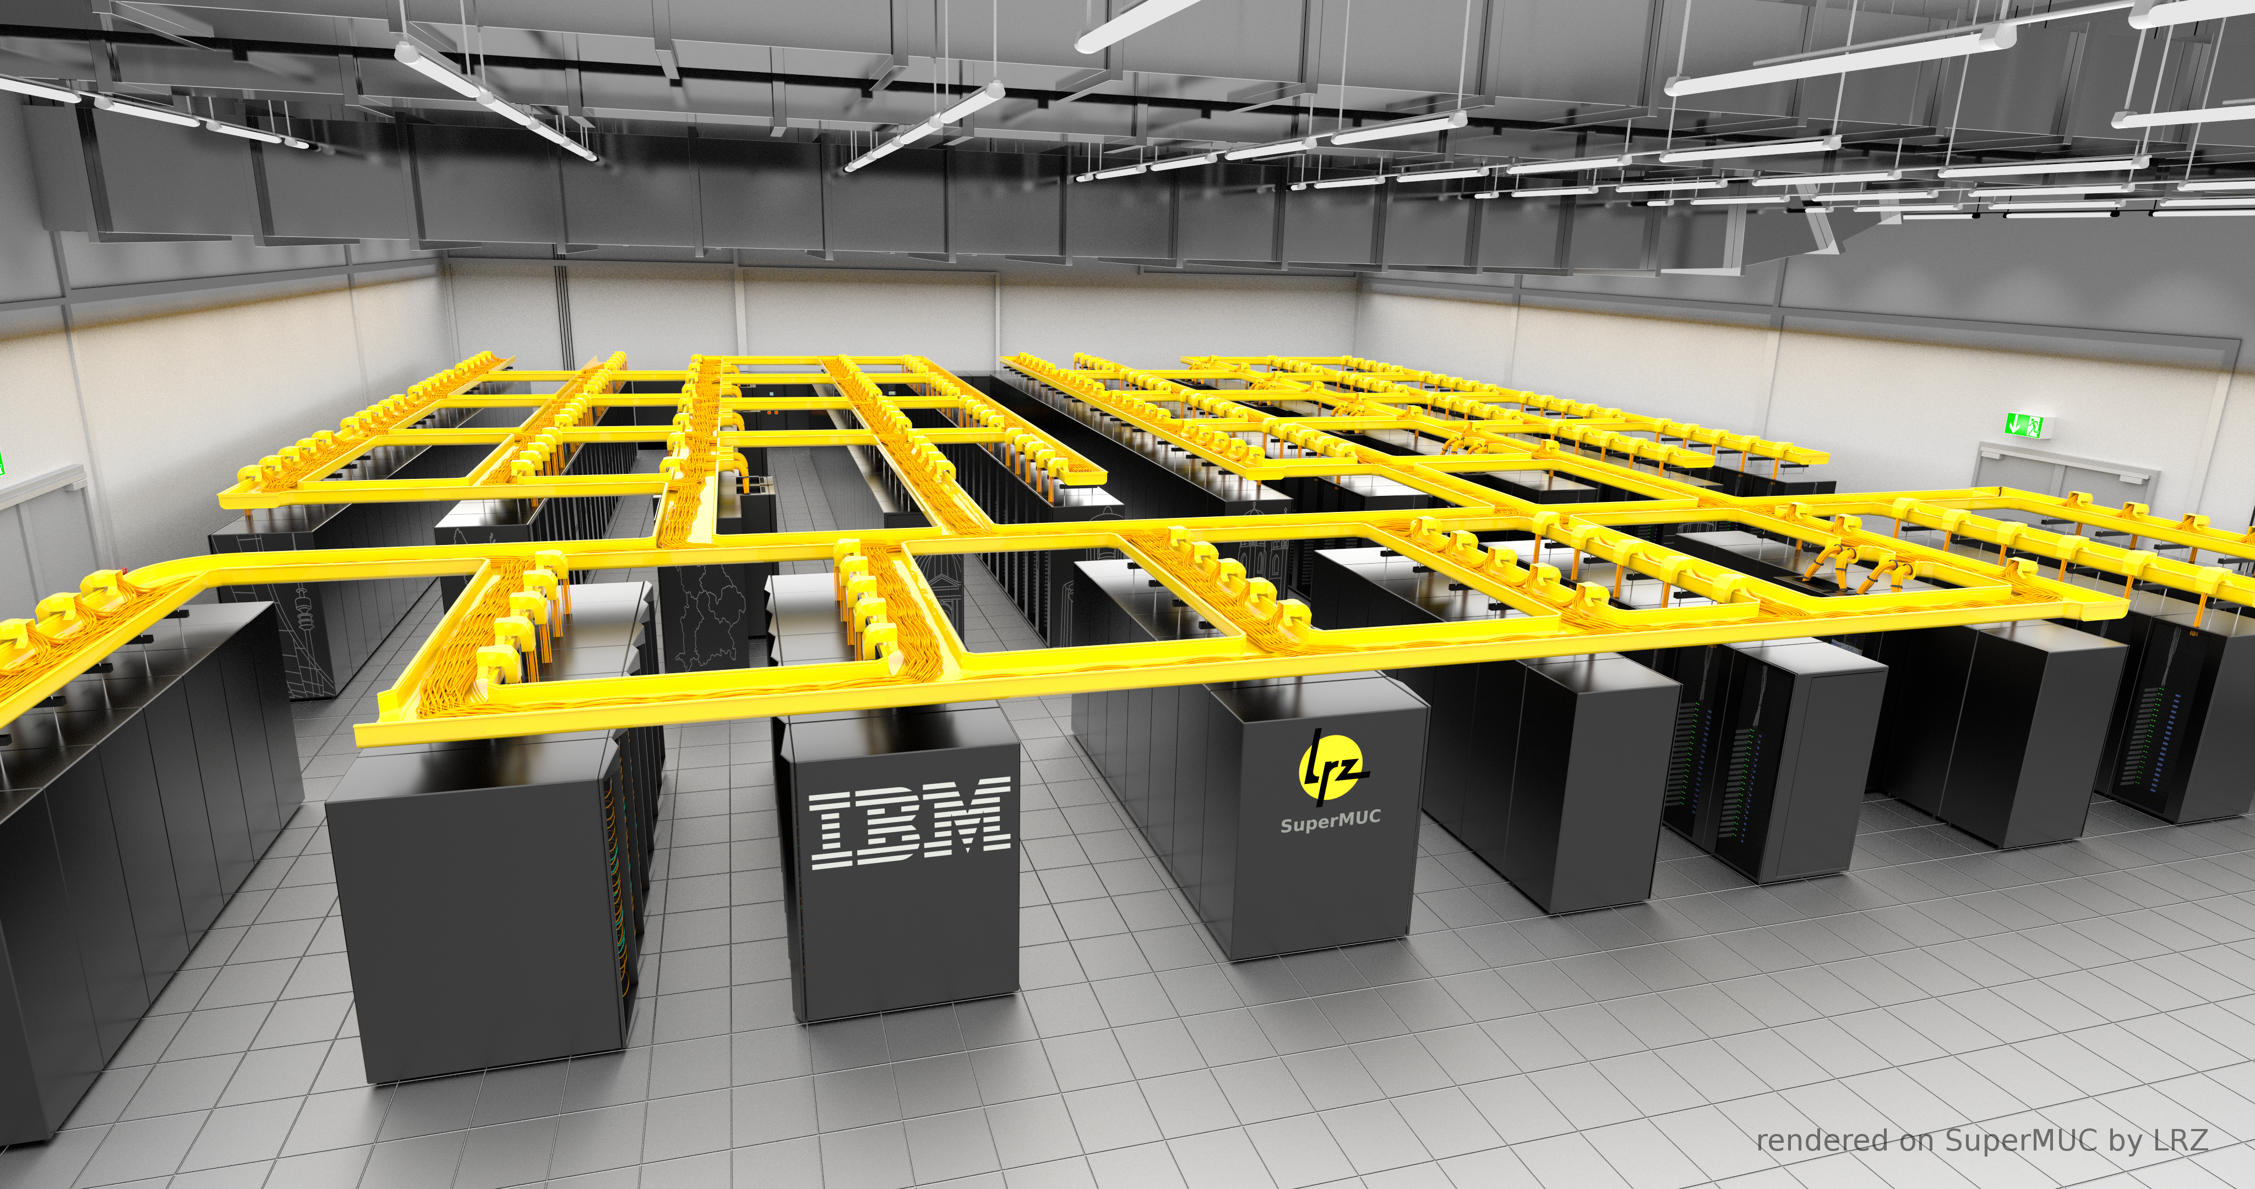
INVASIVE RESOURCE MANAGEMENT
Nishanth Nagendra
MSc. Informatics
DOCTORAL RETREAT @SEEON 2015/2016

Slide 2
AGENDA
Introduction
Resource Management
Support for Invasive computing
SLURM
Architecture
Protocols
Current Status

Slide 3
INTRODUCTION
What is a batch system?
  Middleware for managing supercomputing resources.
  Scheduler + Resource Manager to run parallel jobs.
Classification of Parallel jobs
  Static
  Moldable
  Malleable
  Evolving
Notes:
There are several types of parallelism that can be mentioned here but we restrict ourselves to some of them and especially those which are of interest for us concerning this topic.

Slide 4
RESOURCE MANAGEMENT
Role of a Resource manager?
  The “glue” for a parallel computer to execute parallel jobs.
  Allocate resources within a cluster.
  Launch and otherwise manage jobs.
  SLURM, TORQUE, OMEGA, IBM Platform LSF
Role of a Job Scheduler?
  Queuing and Scheduling.
  Support Scheduling algorithms such as FIFO, Priority, Backfill, Gang etc.
  Support fair share scheduling, advanced reservations, preemption. Optimizations for energy, topology, throughput.
  Maui, LoadLeveler, OAR, SLURM
Notes:
OMEGA by Google: predicts the benefits of scaling up current and pending MapReduce jobs, and apportions some fraction of the unused resources across those jobs according to some policy."
SLURM: Slurm uses a best fit algorithm based on Hilbert curve scheduling or fat tree network topology in order to optimize locality of task assignments on parallel computers

Slide 5
SUPPORT FOR INVASIVE COMPUTING
Existing batch systems usually support only static allocation of resources to applications before job start.
What do we need? Invasive Resource Mgmt.
How do we achieve this?
  Invasive Process Manager.
  Invasive Job Scheduler.
  A generic Protocol to integrate Invasive resource management into existing batch systems enhanced with the Invasive job scheduler.
  Our choice of an existing batch system upon which we demonstrate this: SLURM!!!
Notes:
Frame rule has been used in program verification since 15 yrs.

Slide 6
SLURM
Simple Linux Utility for Resource Management
  A sophisticated Open source batch system with about 500,000 lines of C code today. Started in 2002 at LLNL, spawned into schedmd.
  Used on many of the world's largest computers.
  Fault tolerant, highly scalable, Support many UNIX flavors.
  Slurm's design is modular with several optional plugins.
SLURM Kernel
Authentication Plugin
MPI Plugin
Checkpoint Plugin
Topology Plugin
Accounting storage Plugin
Munge
mvapich
BLCR
Tree
MySQL

Slide 7
ARCHITECTURE FOR INVASIVE RESOURCE MANAGEMENT

Slide 8
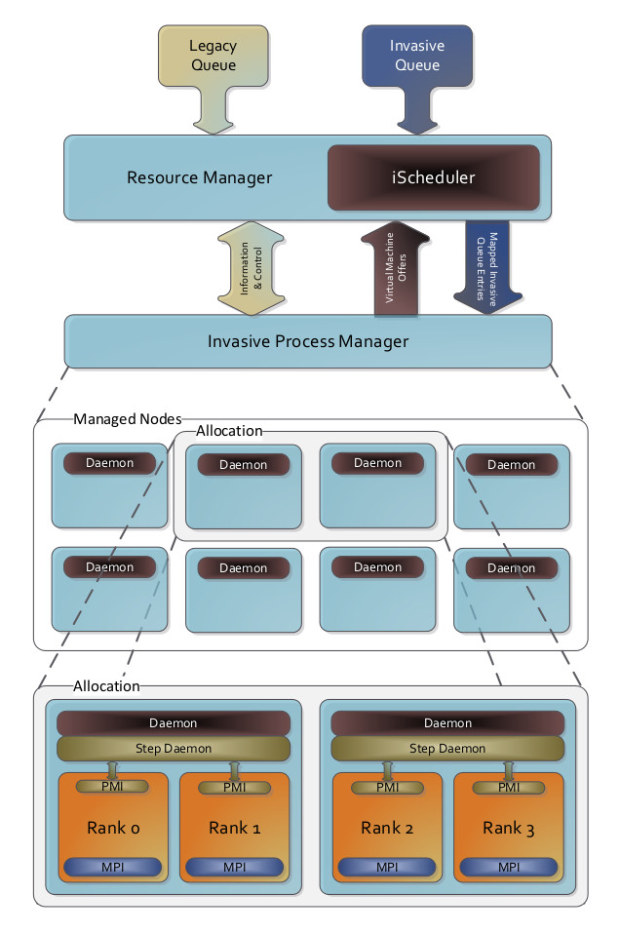
Schedule at a coarse level
of granularity: Nodes.
Negotiates with the iPM
for offers till both agree.
Event based scheduling.
Resource offers influence
scheduling decisions.
Notes:
Resource utilization
Energy
Power
Execution time
Deadlines
Job throughout
Urgent computing

Slide 9
Traditionally schedulers
run periodically, after
new job submissions,
terminations etc.
Traditionally, Scheduler
decisions are not influen
-ced in any manner.
Scheduling decisions
are made to achieve
certain metrics like high
job throughput, reduced
job waiting times, urgent
computing, deadlines,
priorities etc.
Notes:
Resource utilization
Energy
Power
Execution time
Deadlines
Job throughout
Urgent computing

Slide 10
Does a run time schedul
-ing at a finer level of
granularity such as cores
and sockets.
Topology based mapping
Has access to the
internal data structures
of hwloc that represent
the real view of the H/W.
Acts as some sort of a
virtualization layer.
Resource offers could be
the real snapshot of the
system or a virtual view.
Tries to achieve certain
metrics like resource
utilization, energy efficie
-ncy, lower exec times,
power stability.
Also support time sharing
of resources.
Notes:
Resource utilization
Energy
Power
Execution time
Deadlines
Job throughout
Urgent computing

Slide 11
PROTOCOLS
Negotiation protocol.
Feedback protocol.
Management protocol.
Keep alive protocol

Slide 12
Negotiation protocol

Slide 13
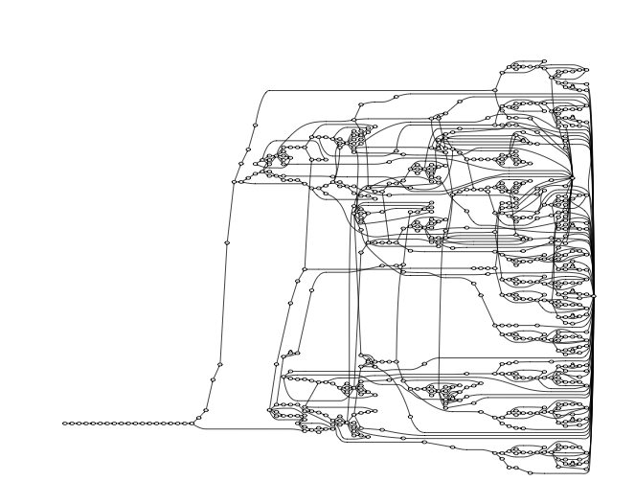
K-CFA study[for k=2]

Slide 14
DESIGN
From a recent paper by the co-author
  LVish side effects are only monotonic updates. If a data structure needs to be updated multiple times then it has to happen out of place resulting in additional memory allocation and turning out to be inefficient relative to their in place versions.
  Blocking get semantics could slow down the performance until the dependency is met. A retry/abort feature has been proposed as a solution towards this. LVish operations are idempotent, Retry and blocking have same semantics.
  Overhead in going through the scheduler repeatedly.

Slide 15
FUTURE WORK
Subsumes many of the existing single assignment models and provides a general model widely applicable for larger set of problems.
Extends the existing theme of monotonicity which has been used as an approach towards providing deterministic by construction parallel programming models.
Related work:
  LVar style threshold reads for CvRDTs(Convergent replicated data types) that are used in a distributed environment.
  Imperative-disjoint parallelism is also now supported in the latest LVish library version.

Slide 16
REFERENCES
Lindsey Kuper, Lattice-based data structures for deterministic parallel and distributed programming. Dissertation, 2014.
Kuper L., Turon A., Krishnaswami N., and Newton R. Freeze after writing: Quasi-deterministic parallel programming with LVars. POPL, Janauary 2014.
Kuper L. and Newton R., Lattice-based data structures for deterministic parallelism. FHPC, September 2013.
Kuper L. and Newton R. Deterministic threshold queries of distributed data structures. Draft, July 2014.
Simon Marlow. Parallel and Concurrent programming in Haskell. O'Reily, 2013.
Lindsey Kuper. Blog. composition.al.
Praveen Narayanan and Ryan R. Newton.Graph algorithms in a guaranteed determinis-tic language. Workshop on Deterministic andCorrectness in Parallel programming (WoDet2014), March 2014.
www.Learnyouahaskell.com, Miran Lipovaca
Haskell, The craft of functional programming, Simon Thompson
Online videos/tutorials, Lambda calculus

Slide 17


